Slide 1



Controlling Cost & Quality of
Facilities Across Large Estates

Slide 2


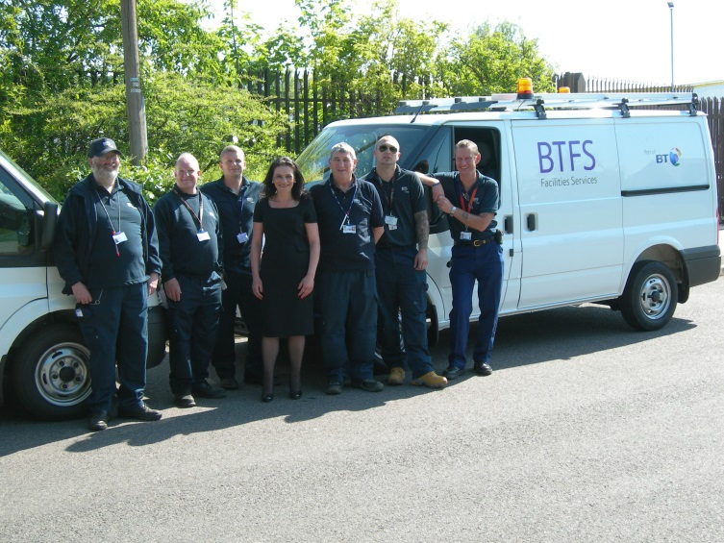
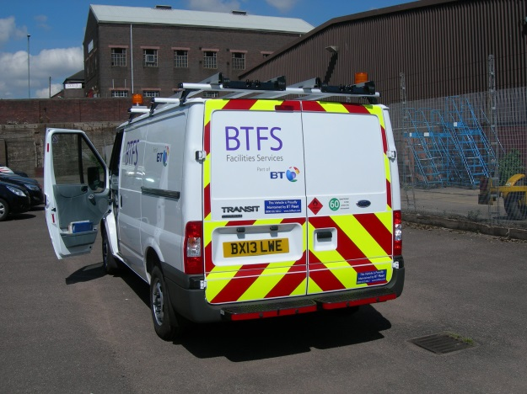
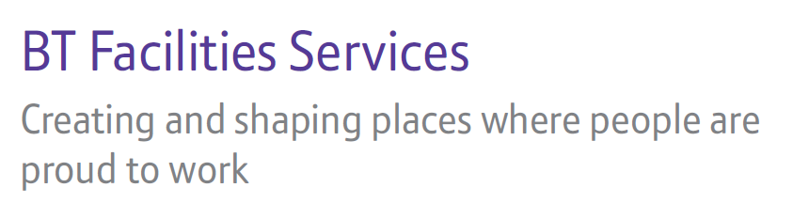

Slide 3

Where we operate….
We manage ~7,000 buildings across ~6,100 locations where 80,000 BT employees work everyday.
              telephone exchanges
              offices
              research premises
              data centres
              radio stations
              warehouses
              depots

Slide 4
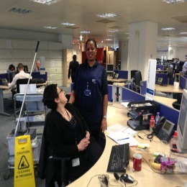
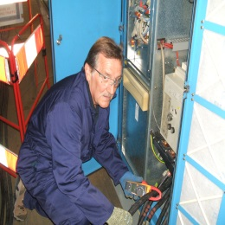
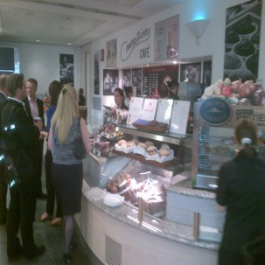
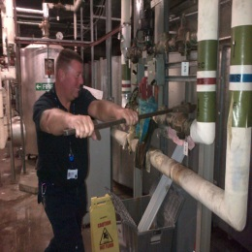
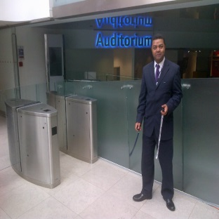
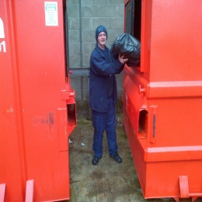
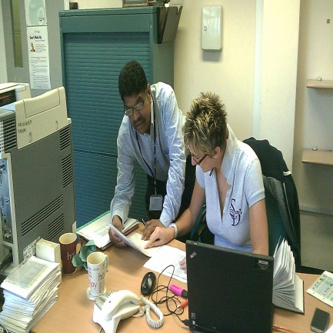

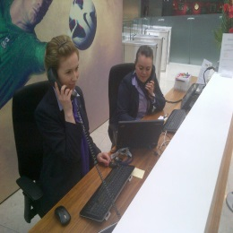
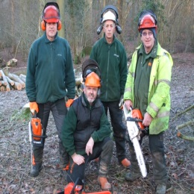
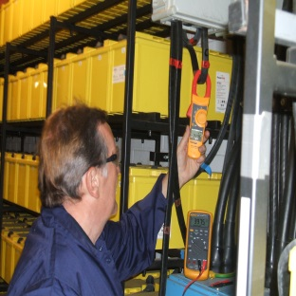
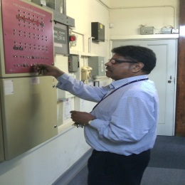
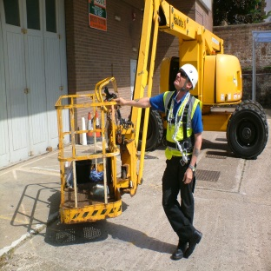
What we do matters….
People
Process
Platforms
……and so does how we do it.

Slide 5



So what about cost management…..
Customer
Service
Understand your customer and their needs
Leadership
CRM
Ownership
Information
Drive up service standards
Drive out waste & inefficiency
Develop a detailed understanding of how best to deliver the services
Then…
…..as ever just get the basics right.

Slide 6
But the one thing you MUST get right…..
Leadership
To deliver cost/service excellence and drive out inefficiency you must create a team that is engaged responsive and adaptable.
You must set a clear Vision, Mission & Strategy with visible and approachable leadership, strong management practices and effective performance management.
Execution (meeting customers needs)
Service Expansion (internal customers)
Service Growth (external customers)
Make a difference today
Create new possibilities
Deliver profitable growth
…..Invest in your people.

Slide 7
So how do we control cost versus quality…..
Hard & Soft services routines
Job standards
Organisational design
Change control & management
Assets under management
Program management
SME’s where appropriate
Service activation
Strong compliance culture
Back to back SLAs
Clear procurement strategy
Benchmark responsibly
P&(L) responsibility
Business case mind-set
Devolved authorities
Value your strengths
Don’t chase lowest price
Cost books
Consistency & Standards
Commerciality
…..we work hard on our “one team” environment.

Slide 8
What you don’t measure you won’t manage…..
We aim to be an learning and evolving organisation.
We strive for effective management information which drives a culture of continuous improvement.
We seek innovation from within and industry leaders, rolling out best practice and trying out new ideas (and getting some things wrong!)
Our MI highlights celebrates great performance as well as non compliance
Our cost books go deep into our business both in terms of the people they touch and the detail they contain.
We aim to share what we know & learn as you never know where the next bright idea may come from.
Business Intelligence
Business Improvement
…..FM needs to do more with the information it has.

Slide 9
So what do we feel works well for us?....
The bigger ticket items
Understand your customer
Leadership & Team
Be clear where you are heading
Consistency & Standards
Commercial focus
Management information

Slide 10

So are we there yet?…..
…..what do you think!.

Slide 11


