Slide 1
Benchmarking groups what they can and cannot do for an organisation…..
Jo Harris
Tracey Tilbry

Slide 2
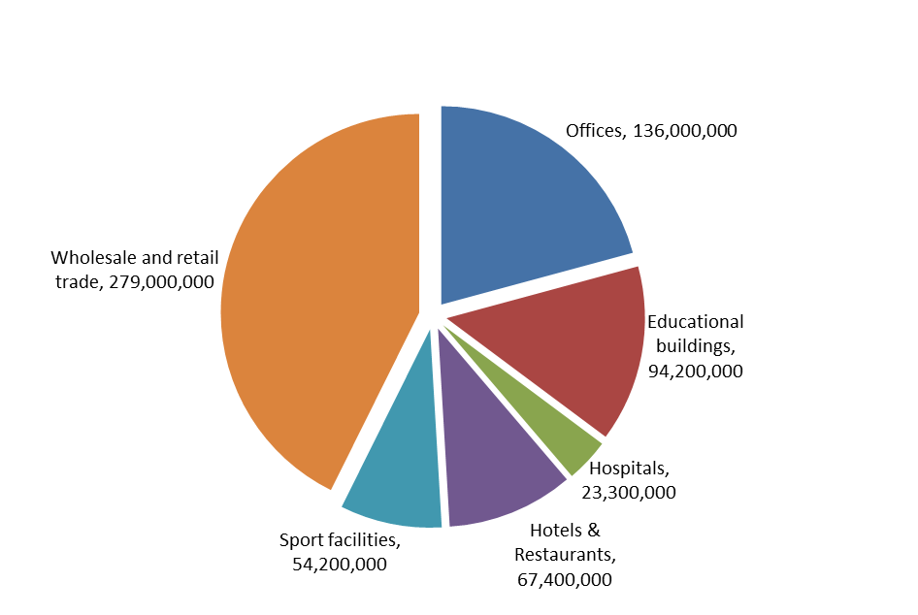
Why benchmark?
Breakdown of total area (m²) of non-residential buildings in the UK
Estimate of total floor area of 654 million m² non–domestic
Identifying ways of reducing
Costs
Environmental impacts
Performance
Notes:
So why do people benchmark? Well we have an estimated 654 million m2 of non domestic floor space in the UK all of which needs to be serviced, maintained and uses electricity to house the business that is operating in that building.
If we look at the sectors that occupy this space you can see it is dominated by the wholesale and retail trades, closely followed by offices and education…. The one thing the all have in common is that they need to run as economically as possible, their occupiers or sometime customers drive their environmental performance and the all need to provide the services their occupiers need and perform the function that has been asked of them.
Benchmarking is the tool that allows all these operators to know if they are doing a good job or whether there are areas that they could be improving

Slide 3
Using the results
It is a tool to show value for money and to communicate with other disciplines such as finance
Maintenance
Total maintenance | Benchmark 2011 | Highest 2011 | Lowest 2011 | Benchmark 2010 | Benchmark 2009 | Example 2011
General offices | £22.66 | £77.87 | £6.18 | £16.96 | £20.95 | £17.42
Estates | £38.61 | £86.81 | £12.52 | £20.80 | £18.50 | £43.82
Laboratory (with office space) | £48.85 | £140.39 | £8.34 |  |  | £50.02
Cleaning | Benchmark 2011 | Highest 2011 | Lowest 2011 | Benchmark 2010 | Benchmark 2009 | Example 2011
General offices | £11.41 | £17.83 | £5.93 | £9.57 | £3.78 | £10.55
Estates | £10.83 | £25.01 |  | £9.75 | £15.63 | £10.15
Laboratory (with office space) | £16.45 | £35.98 | £2.94 | £20.80 |  | £16.45
Notes:
This is an example where the results can be used to focus a busy operators attention. Only one area is greater than the benchmark – so as a guide the operator of these buildings and estates can focus his energy at looking at the figures he has and if they are found wanting he can look to improve the cost control and management of maintenance on those estates.

Slide 4

BSRIA Operations and Maintenance Benchmarking Network
Started in 2001
Give to receive
Peer to peer networking
Help our members evaluate their own buildings and identify potential areas for improvement
  Energy
  Maintenance
  Cleaning
  Security
  Waste
Notes:
So BSRIA’s network has been around since 2001 in one form or another and in 2003 when I joined BSRIA we were sending a question to our members every two weeks to build up a picture of what buildings they were managing and the cost and performance of their operations. The network is run on a give to receive basis and everyone is encouraged to submit data. We also run three events throughout the year to allow networking with other members who are generally like minded individuals that just want to get better at what they are doing. The data we provide each year is aimed at helping our members look at their own results and identify areas for improvement compared to the networks benchmark. The areas we hare focused on at the moment are Energy, Maintenance , cleaning and security which we’ve been collecting reliably for six years and waste which was added about 2 years ago in response to members needs to start improving their environmental performance.

Slide 5
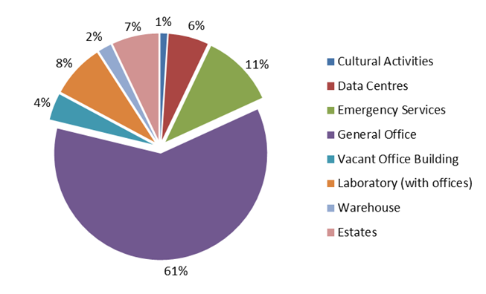
Where does the data come from….
Eight types of building functions:
  Cultural Activities. which includes libraries and museums
  Emergency Services, which is predominately 24hr manned fire stations
  General Office, which also includes all the premier HQ office buildings
  Vacant Office , where the office has no occupants over the whole year
  Laboratory, including the office areas supporting the laboratories in the same building
  Warehouses, which are predominately non air-conditioned only heated
  Estates, where all the buildings are on the same site and supported by a central group
  Data Centres, where the majority of the area is dedicated as server room with some space for support staff
Notes:
We’ve heard it before you cant measure oranges against apples – so we split our categories and capture the background data about the buildings.

Slide 6
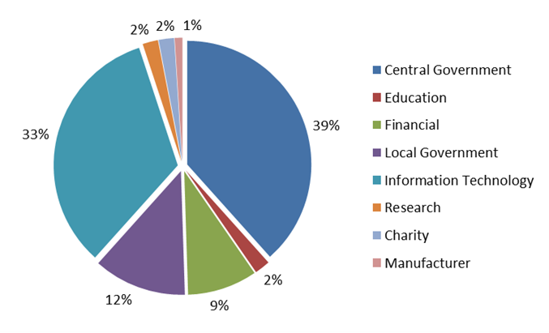
Data returns – by sector
Notes:
We also look at the sectors the data comes from as there is a big different in the amount a charity will send on their HQ office compared to a financial institute!

Slide 7
Maintenance Activities
Activities | % of respondents included in costs
Reactive repairs | 96%
PPM (Planned Preventative Maintenance) | 89%
Fabric | 88%
Call out facility | 86%
Out of hours | 86%
Controls | 86%
KPI's | 82%
SLA's | 79%
M&E Team | 78%
Asset list | 78%
Spares | 67%
Mobile Team | 59%
Handyman | 55%
Helpdesk | 44%
Health & Safety | 40%
Staff cover | 40%
Project work | 34%
Notes:
Other influences are the activities that are undertaken – if we look at maintenance you can see that reactive repairs is almost a given that everyone you are benchmarking against will also be paying for that service as well. But when you get down to things like the helpdesk – if you are paying for this but your peers are not… the figures will be very different.

Slide 8
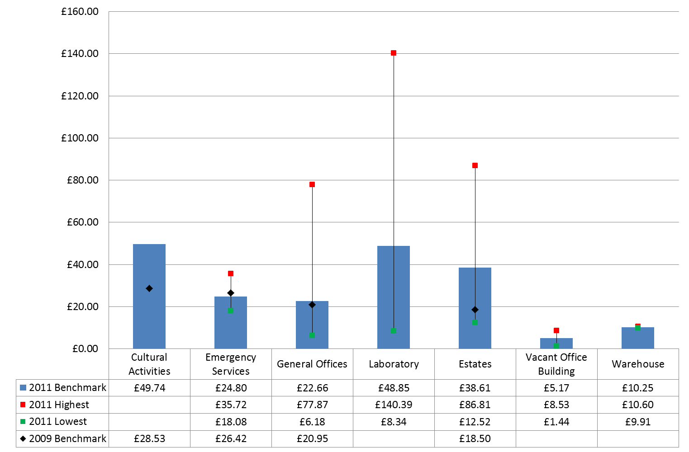
Total maintenance costs
Notes:
This is reflected in the range that we get – to read this chart the red is the highest cost per m2 GIA that is submitted by the members, the green is the lowest with the blue bar the benchmark for each class of building. The black spot s the benchmark from the previous year. The thing with this type of benchmarking which relies on groups submitting their data is that the data set is not fixed….. So that the number as well as the buildings submitted changes year on year and can be the reason the benchmark fluctuates.

Slide 9
Summary
Benchmarking from groups is not an exact process
The benchmarks are intended to guide you
BSRIA’s benchmarks are derived solely from the data the O&M Benchmarking Network members provide and is not published
Data submissions vary year on year which affects the benchmarks
Next event - July 18th – Build Services, Keeping you informed
Notes:
So in summary you have to remember working from benchmarks produced from groups it is only as good as the data that is submitted. Those that run groups will validate and test the data they receive as much as possible – we work hard on this visiting our members to collect the data when necessary.

