Slide 1
High-level benchmarking Scientific Research Organisation – 150,000sq.m
Jo Harris

Slide 2
Scope of project
High-level benchmark required
Initial view on delivery process and options

Slide 3
Methodology
One day to visually inspect a representative sample
Information on:
dimensions of the building
breakdown of costs
costs of specialist sub-contract works
Use IFPI’s EstatesMaster Facilities Benchmarking and Cost Prediction program at High-level (Level 1)
Initial consideration and commentary for maintenance delivery and management
Discuss preliminary findings
Written Report
Notes:
of the buildings and building services to establish the complexity and scale of operations

Slide 4
Information made available
Total floor area – 150,000 m2 GIA
Expenditure on reactive and planned maintenance – approx. £5m p.a.
Specialist sub-contracts information - Compressed Air only received
500 planned maintenance tasks recorded on the asset data-base
2800 reactive maintenance requests p.a.(estimated)
The M+E maintenance of the specialist laboratory buildings have an independent maintenance regime and are excluded

Slide 5
Enhancements
Used Level 2 of EstatersMaster because of the apparent discrepancy between the results from Level 1 and the £5m budget
More site details reviewed
Pump list – Heating and Cooling
Schedule of Air Compressors
Schedule of LPHW Boilers
Schedule of Cranes and Lifting Equipment
Schedule of Lifts
Schedule of Fire Alarm Devices
Fabric maintenance included

Slide 6
Results
Omitting the experimental laboratories entirely; not skewed by the presence of a large area of minimally serviced building.
Benchmark range from £1.1 - £1.4 m p.a.
Median benchmark for maintenance of £1.25m p.a.
£17 per m² GIA (after removing the specialist buildings)
Intelligent Client Function not working with an adhoc approach to maintenance management and ‘fire-fighting’

Slide 7
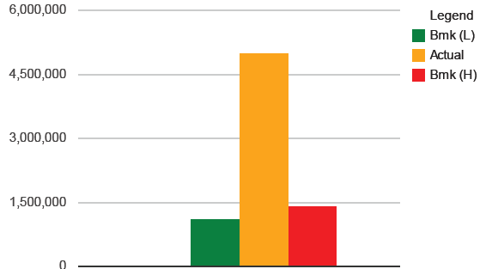
How to increase accuracy
Scope - work outside the scope of the cost centre
Answers - quality and difficulty of the services
Data - building details

Slide 8
Adjustment for out-of scope items
Scope – Life-cycle replacement
Minor building works

Slide 9
How to increase accuracy
Scope - work outside the scope of the cost centre
Answers - quality and difficulty of the services
Data - building details

Slide 10
Summary
High level benchmark to review current delivery
Level of information is the key to an accurate result
Notes:
The more information you put in the better the result

